Slide 1
Employee Data Analysis using Excel
STUDENT NAME:V. PRIYADARSHINI
REGISTER NO:422200506
DEPARTMENT: B.COM(Ism)
COLLEGE: VALLIAMMAL College FOR WOMEN

Slide 2
PROJECT TITLE
Employee Performance Analysis using Excel

Slide 3
AGENDA
1.Problem Statement
2.Project Overview
3.End Users
4.Our Solution and Proposition
5.Dataset Description
6.Modelling Approach
7.Results and Discussion
8.Conclusion

Slide 4
PROBLEM STATEMENT
This Performance analysis is used to find out the employee performance level growing or not

Slide 5
PROJECT OVERVIEW
Analyse the performance level of the employee by considering various factors of like empID,business unit,gender,current empolyee rating,employee type etc,.We use these in order to identify the trends.In this chart different categories of employee performance level like very high,high,med,low.

Slide 6
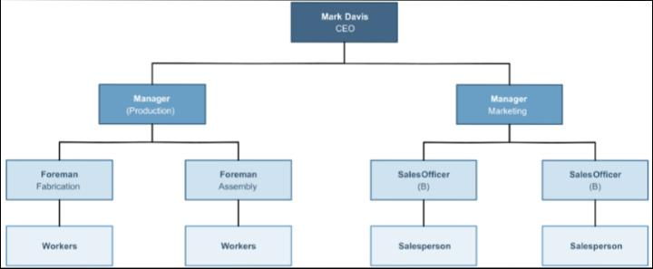
WHO ARE THE END USERS?

Slide 7
OUR SOLUTION AND ITS VALUE PROPOSITION
Conditional formating- Blank values.
Sort and Filter-Filter-Remove Blank values.
Formula-current empolyee rating performance level.
Pivot Table-Summary.
Chart or Graph-Data Visualization

Slide 8
Dataset Description
Employee Dataset-Edunet Dashbord.
27 Features.
11Features.
Employee ID-Numerical values.
Name-Text.
Gender-Text.
Performance level-numerical values.
Start Date- Numerical Value

Slide 9
THE "WOW" IN OUR SOLUTION
We using this formula=IFS(Z8>=5,”VERYHIGH”,Z8>=4,”HIGH”,Z8>=3,”MED”,TRUE,”LOW”)
To find the performance level of the empolyee.

Slide 10
MODELLING
DATA COLLECTION:
Naan Mudhalvan
Edunet Dashboard.
FEATURE SELECTION:
27Features.
11Features.
DATA CLEANING:
Colour blank values
Fliter-Remove Blank values

Slide 11
PERFORMANCE LEVEL:
Very High
High
Medium
Low
PIVOT TABLE:
Empolyee ID
Name Gender
Current rating performance
Performance Level
Start date
Employee Type

Slide 12
RESULTS

Slide 13
conclusion
While comparing the performance level of the employee. The empolyee’s are getting their employee performance level according to their empolyee type and start date.

